Slide 2
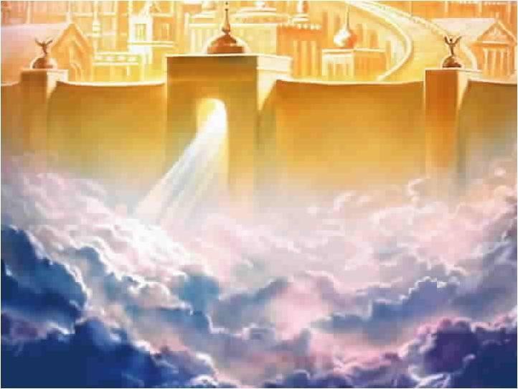
Heaven
and
Hell

Slide 3
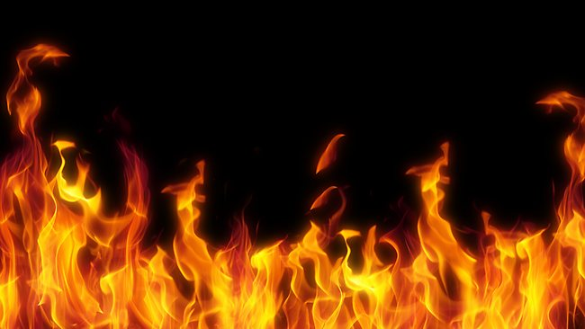
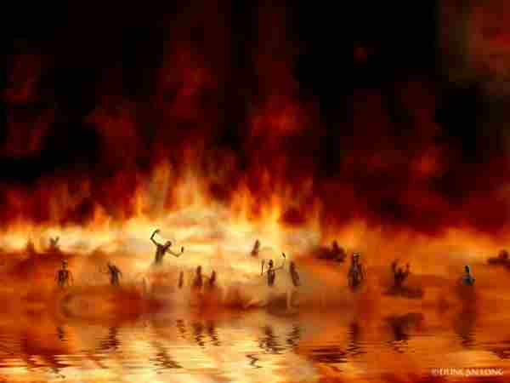
Hell!
What is it Really Like

Slide 4
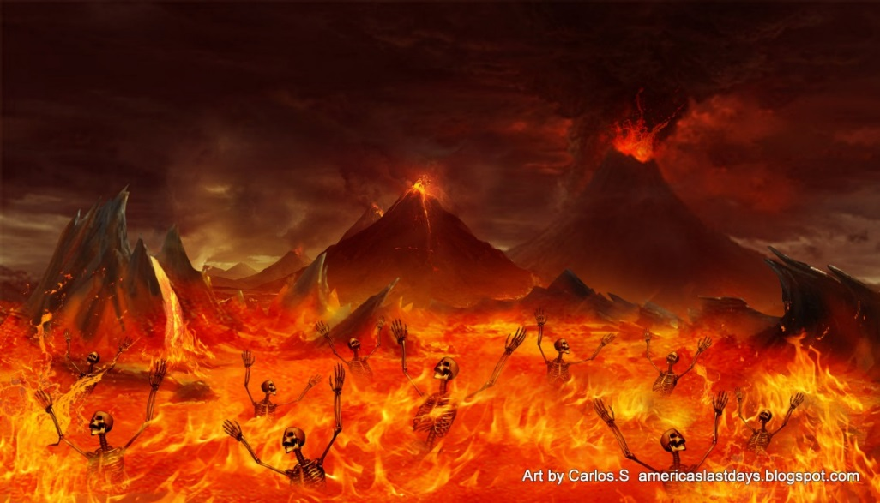
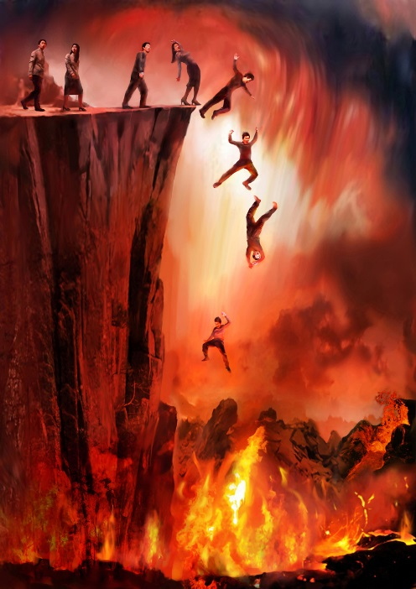

Slide 5
Hell is
a Bad, Bad, Place!

Slide 6
Terms Used
Hell – English Translation of Hades

Slide 7
Terms Used
Hades –
Untranslated Greek

Slide 8
Terms Used
Gehenna
The Valley of Hinnom
S.W. of Jerusalem

Slide 9
Terms Used
Sheol
Untranslated Hebrew
The Place of the Dead

Slide 10
Views About Hell
Views that there will be No Everlasting Torment

Slide 11
Views About Hell
Annihilationism
People Cease to Exist

Slide 12
Views About Hell
Annihilationism
Popular View
British Evangelical

Slide 13
Views About Hell
Universalism
Everyone is Saved

Slide 14
Views About Hell
Universalism
Popular View
Rob Bell, “Love Wins”

Slide 15
Views About Hell
Unconscious Torment
Pain that a Person is
Not Aware that
He is Experiencing

Slide 16
Views About Hell
Spiritual Torment
Pain that a Person Experiences is Mental,
but Not Physical

Slide 17
Views About Hell
The View that Hell will be Intolerable

Slide 18
Views About Hell
The View that Hell will be an Fiery Place of Eternal Physical and Mental Torment, But…

Slide 19
What is Hell?
The Bible Tells us Very Little about Hell

Slide 20
What is Hell?
God has Promised
Not to Let the Evil Man
to go Unpunished
(Prov. 11:21, Nahum 1:3)

Slide 21
The LORD God, compassionate and gracious, slow to anger, and abounding in lovingkindness and truth; who keeps lovingkindness for thousands, who forgives iniquity, transgression and sin; yet He will by no means leave the guilty unpunished,” (Exodus 34:6-7a)

Slide 22
What is Hell?
Punishment Involves
some Kind of
Pain or Torment
(Luke 16:23)

Slide 23
What is Hell?
The Degree or Intensity of the Torment
is Unknown

Slide 24
What is Hell?
Whether the Torment Varies in Intensity
is Unknown

Slide 25
What is Hell?
Fire = Judgment
Eternal Fire =
Eternal Punishment
(Matthew 25:41, 46)

Slide 26
What is Hell?
There is no Escape from the Daily Experience
of the Lake of Fire
(Rev. 14:11; 20:10, 15)

Slide 27
“And the smoke of their torment goes up forever and ever; they have no rest day and night, those who worship the beast and his image, and whoever receives the mark of his name.” (Rev. 14:11)

Slide 28
“the devil who deceived them was thrown into the lake of fire and brimstone, where the beast and the false prophet are also; and they will be tormented day and night forever and ever.” (Rev. 20:10)

Slide 29
“And if anyone's name was not found written in the book of life, he was thrown into the lake of fire.” (Rev. 20:15)

Slide 30
What is Hell?
The Intensity of their Punishment will be Determined by their
Evil Deeds

Slide 31
What is Hell?
“the dead were judged from the things which were written in the books, according to their deeds.”(Rev. 20:15)

Slide 32
What is Hell?
“for whatever a man sows, this he will also reap. For the one who sows to his own flesh will from the flesh reap corruption…” (Gal 6:7-8a)

Slide 33
A Tour of Hell
Old Testament
A Trip to Sheol
Isaiah 14:9-11

Slide 34
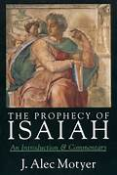
A Tour of Hell

Slide 35
A Tour of Hell
New Testament
A Look at Hades
Luke 16:19-31

Slide 36
A Tour of Hell
The Rich Man, Lazarus, Abraham and Moses

Slide 37
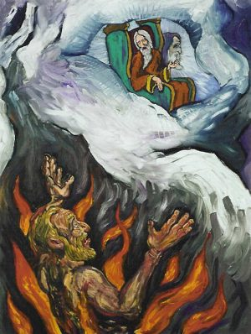
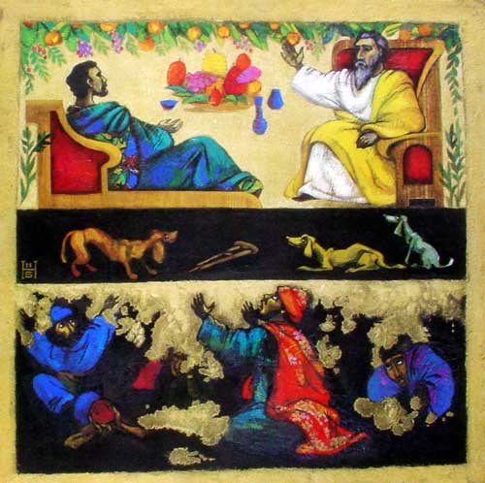
A Tour of Hell

Slide 38
A Tour of Hell
Context
Luke 15-16

Slide 39
“Do not be deceived, God is not mocked; for whatever a man sows, this he will also reap. For the one who sows to his own flesh will from the flesh reap corruption…” (Gal 6:7-8)

Slide 40
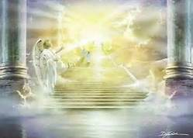
A Wicked Resurrection
Revelation 20:13

Slide 41
“And the sea gave up the dead which were in it, and death and Hades gave up the dead which were in them; and they were judged, every one of them according to their deeds.” (Rev 20:13)

Slide 42
“Many of those who sleep in the dust of the ground will awake, these to everlasting life, but the others to disgrace and everlasting contempt.” (Dan 12:2)

Slide 43
A Where is Hell?
Center of the Earth
Different Universe?

Slide 44
Sharing Our View of Hell
The Gospel of John
No Hell

Slide 45
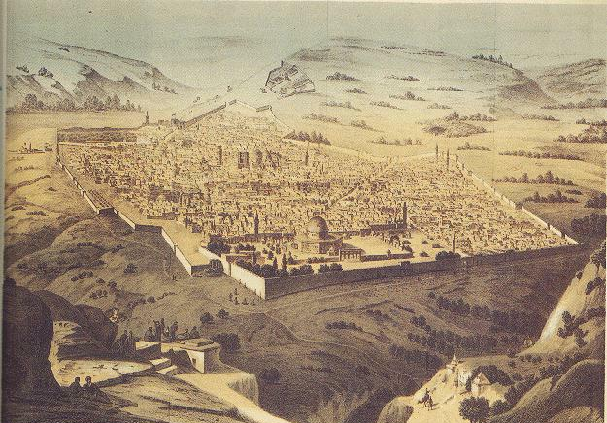
A Word About Gehenna

Slide 46
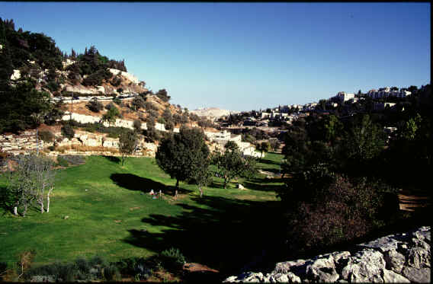
A Word About Gehenna

Slide 47
Hell’s
Conclusion

